Slide 1
continuous
happiness
by
continuous
delivery

Slide 2
sergejus barinovas
@sergejusb

Slide 3


50+
releases / day at
facts
8min
to spin 500 cassandras at

Slide 4

10+
facts
releases / day at

Slide 5

why
but

Slide 6
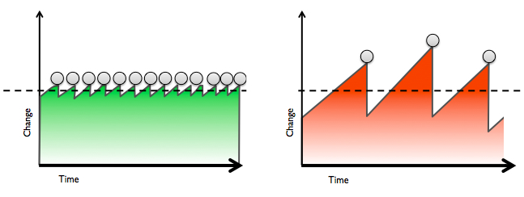
rare releases
higher risk

Slide 7
frequent releases
lower risk

Slide 8
how
but

Slide 9
by
continuous
delivery

Slide 10
continuous delivery
RAPIDLY
REPEATEDLY
RELIABLY
AT
low risk
features
push
techniques to
out
minimal manual overhead
bug fixes
WITH
Notes:
set of techniques to rapidly, reliably and repeatedly push out enhancements and bug fixes to customers at low risk and with minimal manual overhead

Slide 11
infrastructure automation
continuous delivery
continuous deployment
continuous integration

Slide 12
continuous integration

Slide 13
automated tests
automated builds
continuous integration
version control

Slide 14
version control
1
always version your files
2
make it source of truth
3
make it friendly to use
4
distributed over centralized

Slide 15
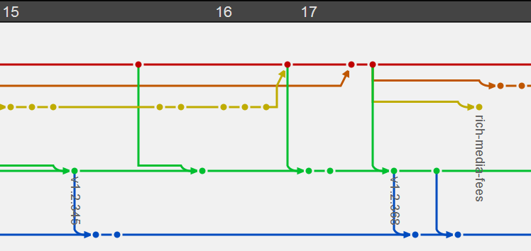
SVN
mercurial
GIT
perforce
bazaar
TFS

Slide 16
automated tests
1
design for testability
2
make them part of DNA
3
make them fast & reliable
4
quality over quantity

Slide 17
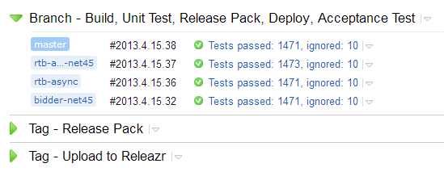
integration
stubs
mocks
UNIT
fakes
functional

Slide 18
automated builds
1
make them effortless
2
always use CI servers
3
make them discoverable

Slide 19
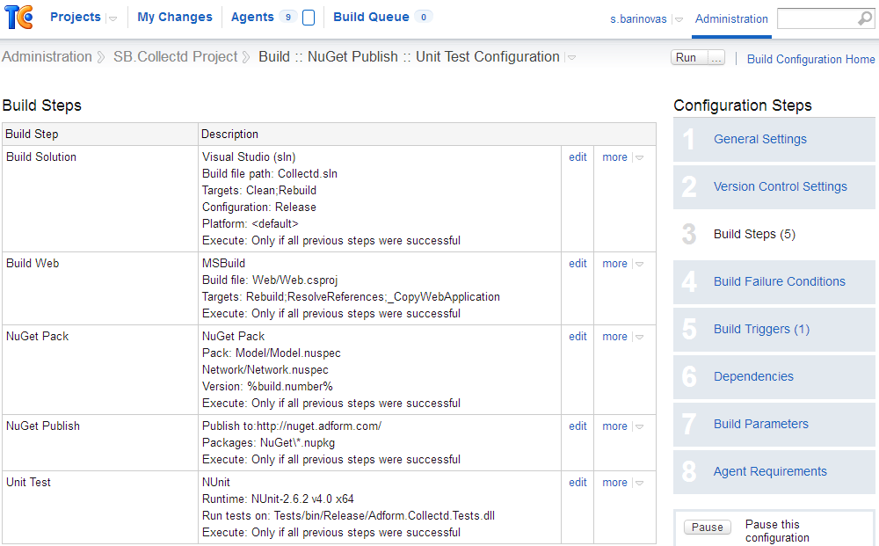
jenkins
teamcity
TFS
hudson

Slide 20

infrastructure automation
continuous delivery
continuous deployment
continuous integration

Slide 21
continuous deployment

Slide 22
deployment dashboard
monitoring & metrics
continuous deployment
deployment packages

Slide 23
deployment packages
1
scripts over manual work
2
externalize configuration
3
make them part of CI

Slide 24
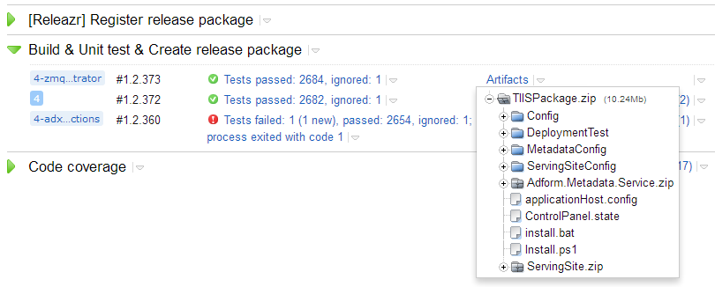
MAKE
power shell
RAKE
python

Slide 25
deployment dashboard
1
use automated deploy tool
2
make it visual & easy
3
trust over restrictions
4
keep everyone informed

Slide 26
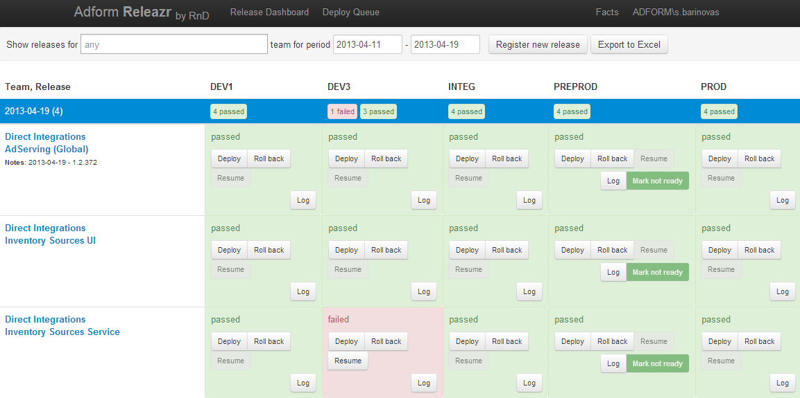
go
octopus

Slide 27
monitoring & metrics
1
for hardware & software
2
make it visual & easy
3
make it reliable
4
use it for business

Slide 28
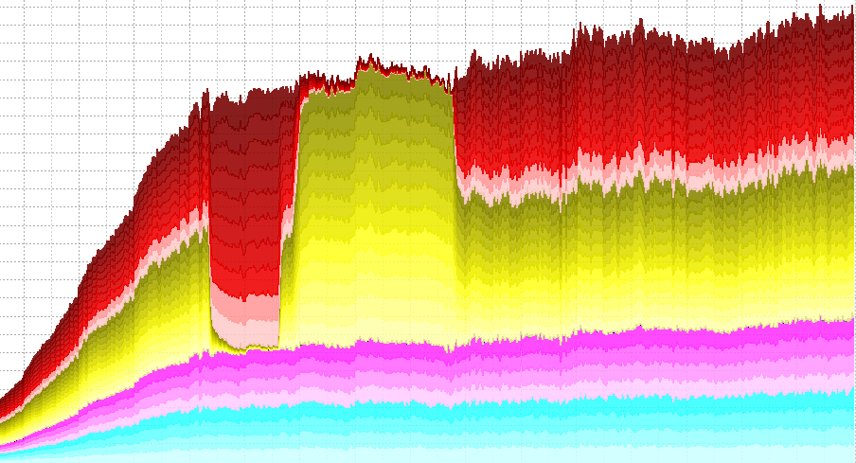
nagios
munin
zabbix
ganglia
cacti

Slide 29
infrastructure automation
continuous delivery
continuous deployment
continuous integration

Slide 30
infrastructure automation

Slide 31
infrastructure automation
1
start with configuration
2
make it for virtual machine
3
make it for cluster
4
make it visual & easy

Slide 32
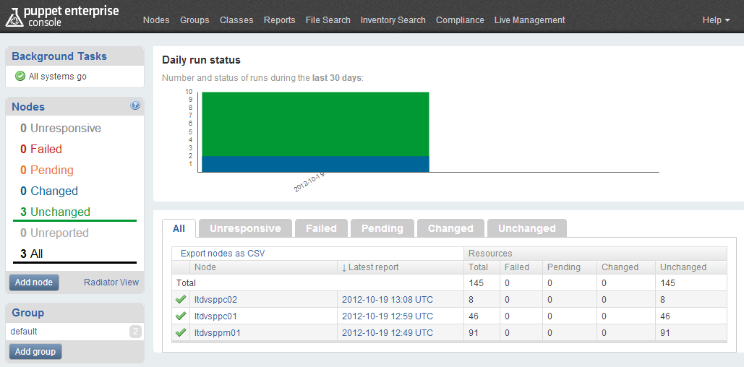
puppet
chef

Slide 33
infrastructure automation
continuous delivery
continuous deployment
continuous integration

Slide 34
thanks
sergejus barinovas
@sergejusb

